Slide 1
Regularization techniques
L1 and L2 Regularization
By - Chhanak Tank
- Manas Ganti

Slide 2
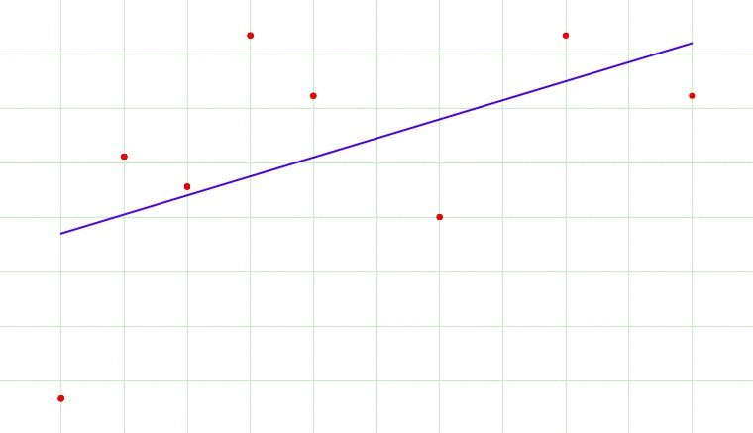
Regularization
Regularization is a technique used to reduce the errors by fitting the function appropriately on the given training set and avoid overfitting.
Overfitting occurs when a Machine Learning model is fit extremely well to a training set and is not able to perform well on unseen data.
The main idea of a regularization technique is to find a new line for the regression function that purposely doesn’t fit well so to allow some noise.

Slide 3
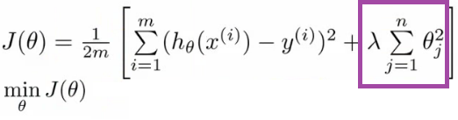
Now, there are few ways you can avoid overfitting your model on training data like cross-validation sampling, reducing number of features, pruning, regularization etc.
Regularization basically adds the penalty as model complexity increases. Regularization parameter (lambda) penalizes all the parameters except intercept so that model generalizes the data and won’t overfit.
.

Slide 4
RIDGE REGRESSION
(L2)

Slide 5
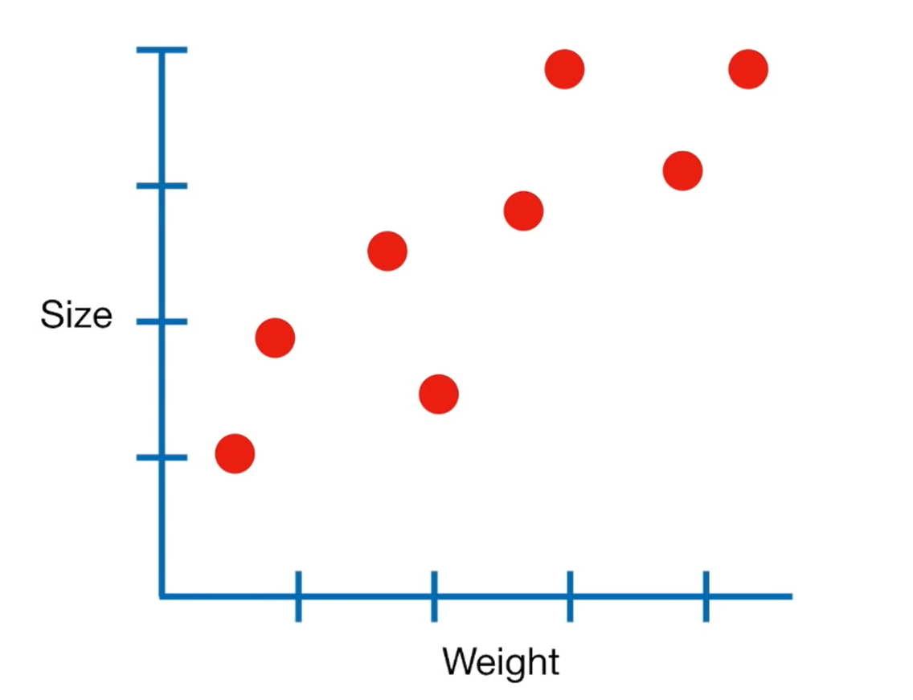
RIDGE REGULARIZATION (L2)
Let’s start by collecting weight and size measurements from bunch of mice.
Since these data looks relatively linear, we will use Linear Regression , AKA Least Squares, to model the relationship between weights and size.

Slide 6
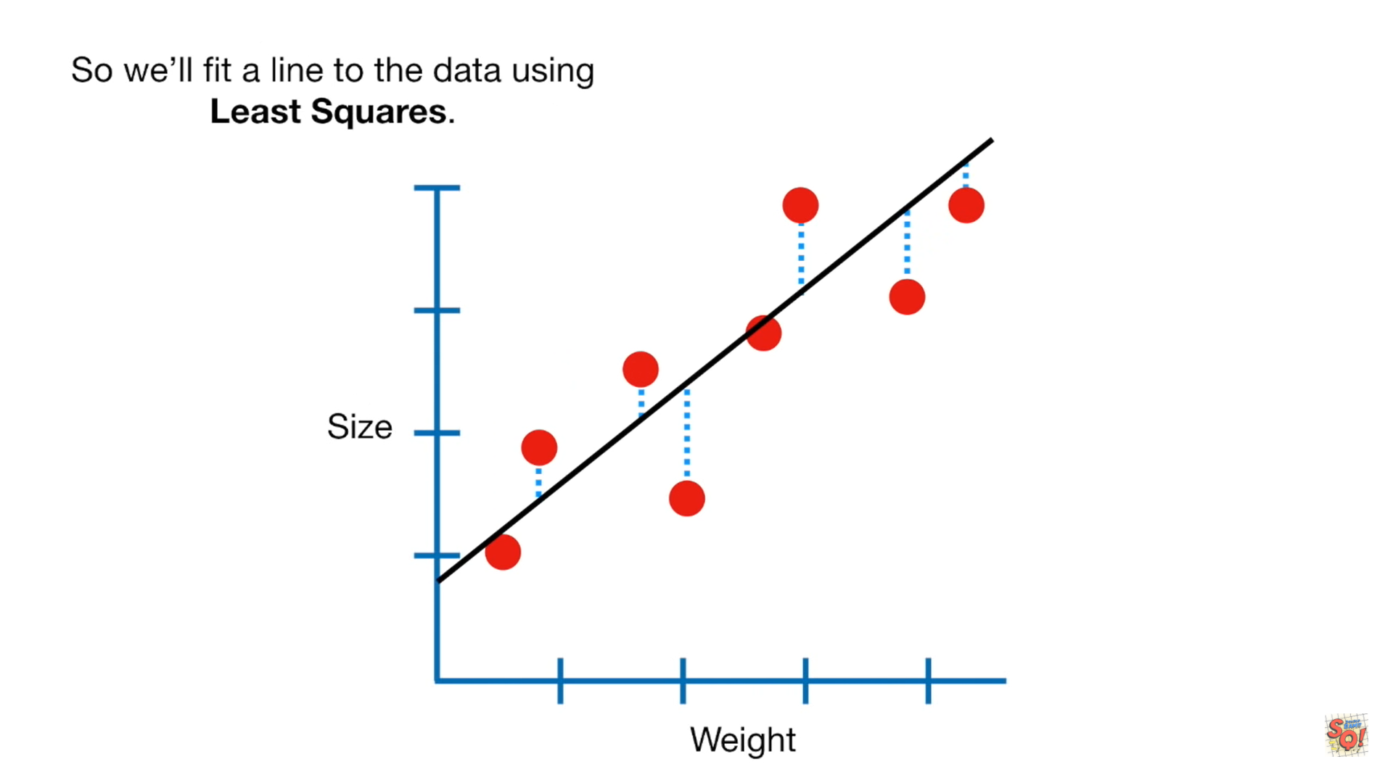
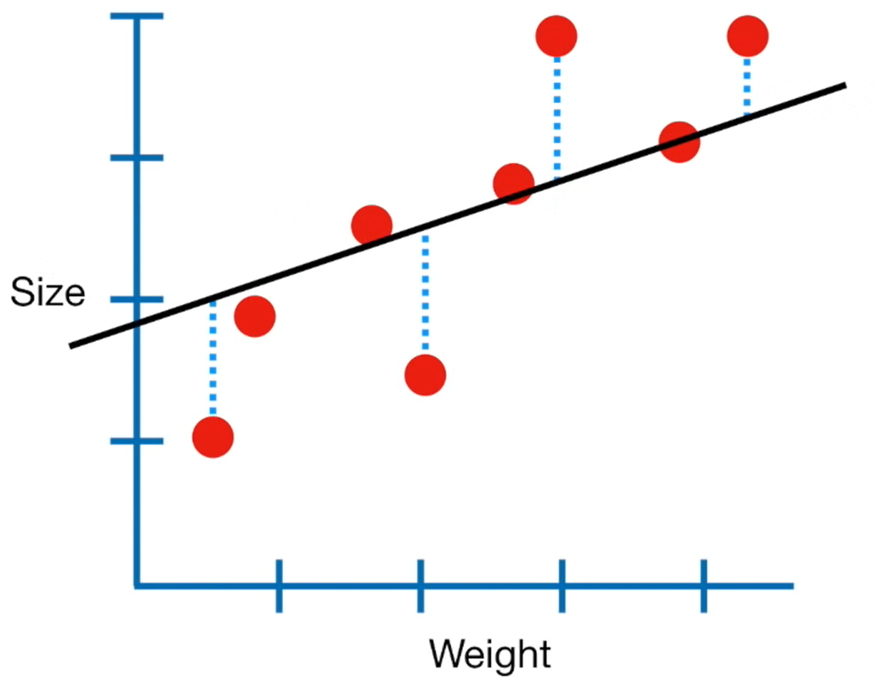
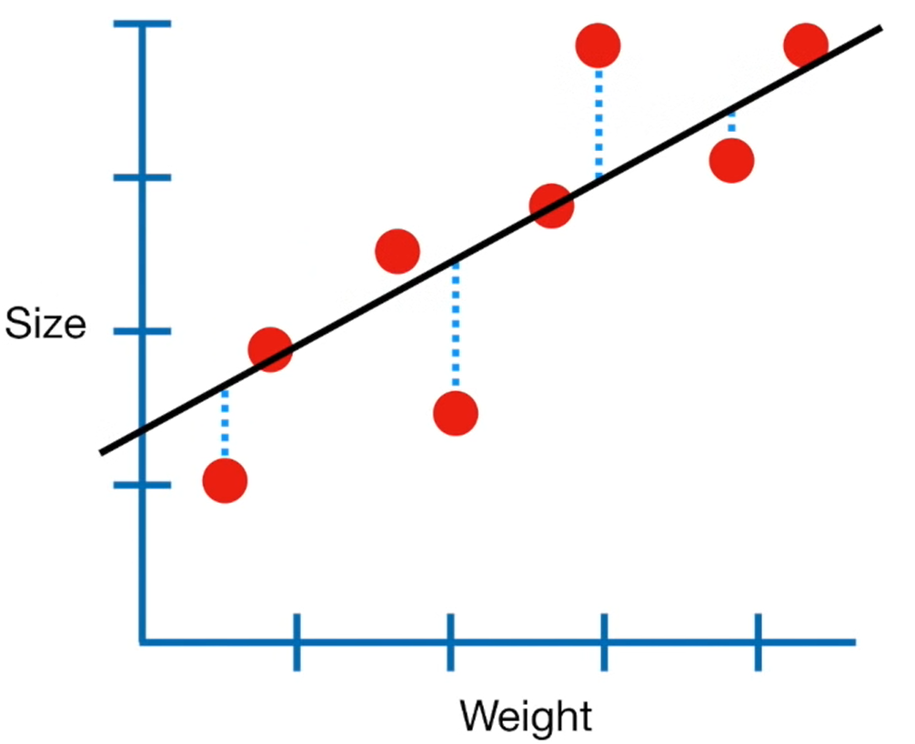
So we’ll fit a line to the data using Least Squares.

Slide 7
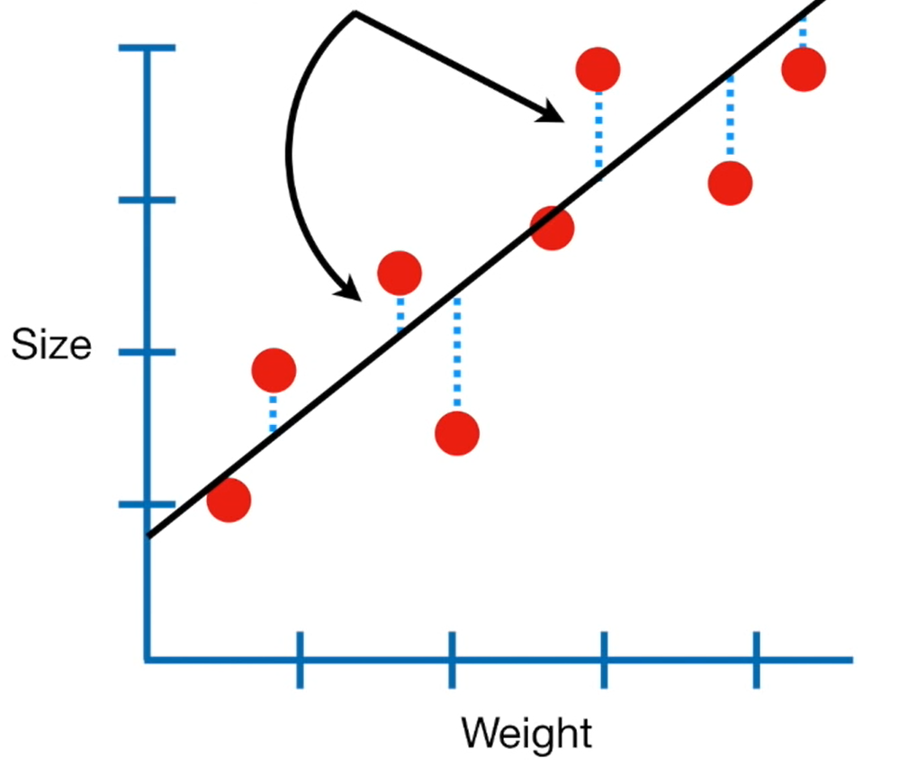
In other words, we find the line that results in the minimum sum of squared residuals.

Slide 8
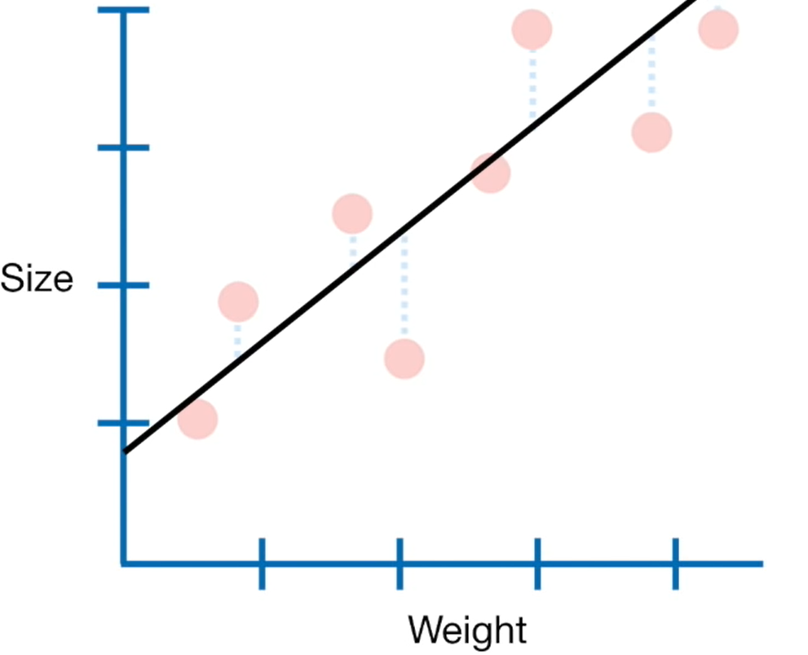
Ultimately, we end up with this equation for the line:
Size = C+ m x Weight
Y-axis intercept
Slope
The line has two Parameters :
Y-axis intercept
Slope

Slide 9
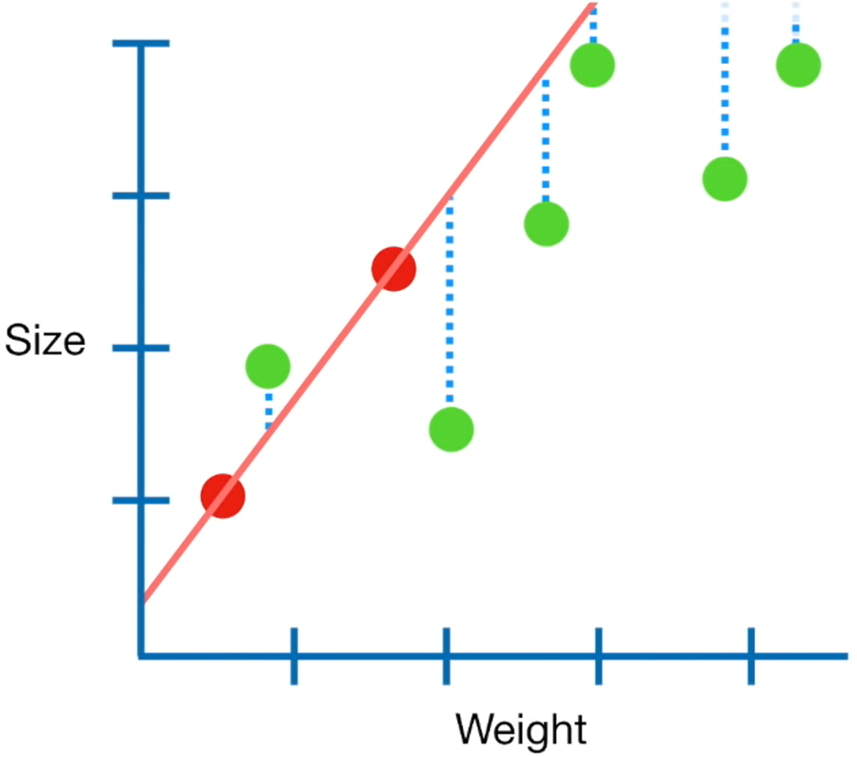
Let’s call the two red dots the training data , and the remaining green dots the testing data.
The sum of the squared residuals for just the two red points, the training data is small ( in this case it is zero)
But the sum of the squared residuals for the green points, the testing data is large.
And that means the new line has high variance.
In machine learning, we say that the new line is over fit to the training data.

Slide 10
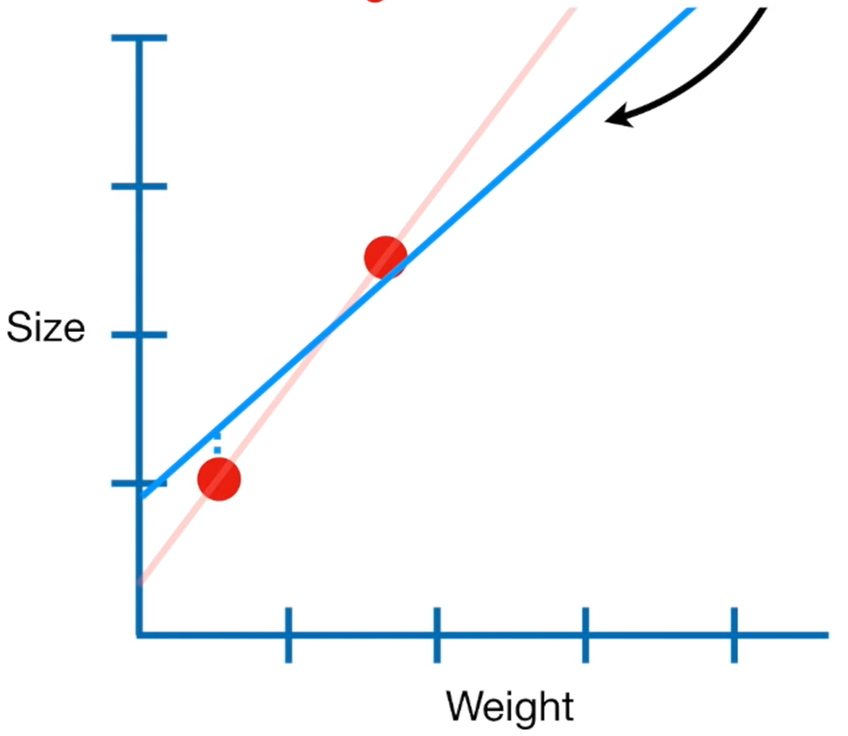
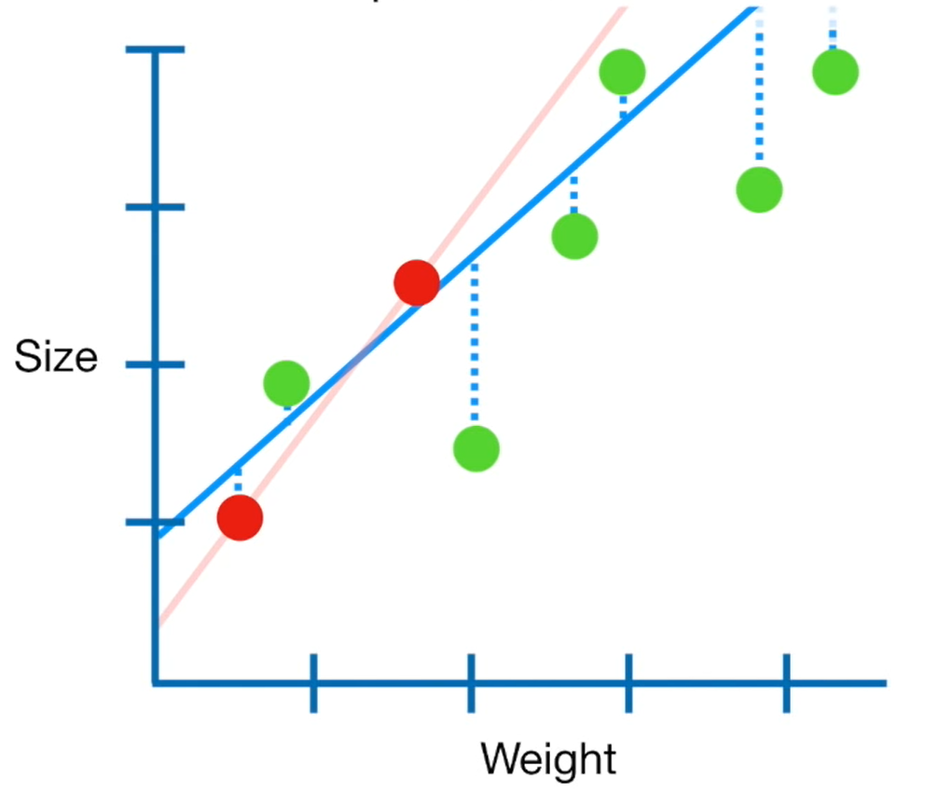
Now let’s go back to the training data.
We just saw that least squares results in a line that is over fit and has high variance.
The main idea behind RIDGE REGRESSION is to find new line that doesn’t fit the training data as well.
In other words, we introduce a small amount of bias into how the new line is fit to the data.
But in returns for the small amount of bais, we get a significant drop in variance.
In other words, by starting with a sightly worse fit, RIDGE REGRESSION can provide better long term predictions.

Slide 11
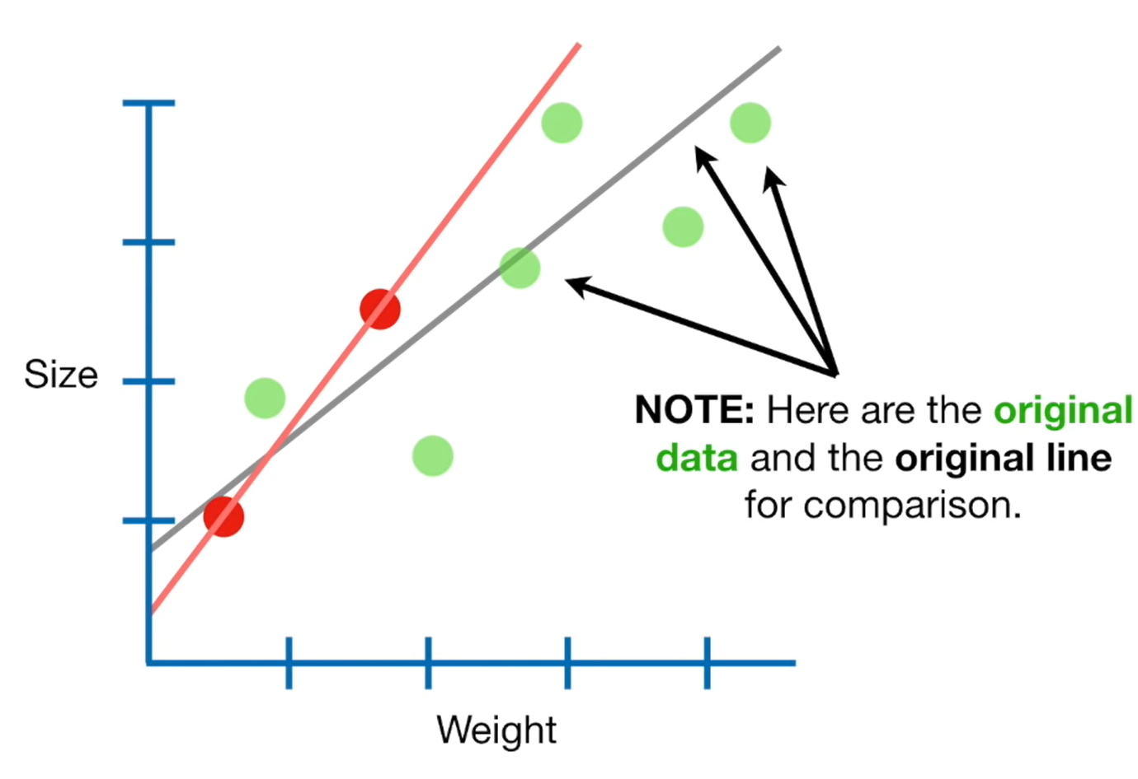

Slide 12
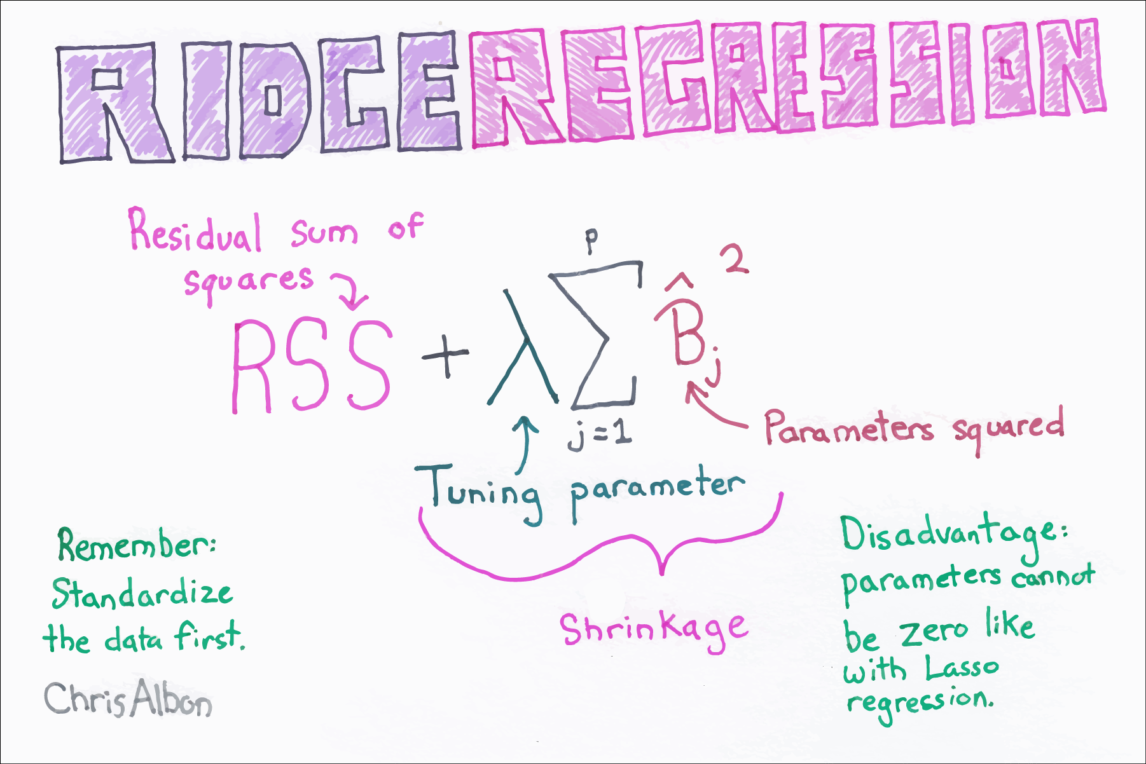
RIDGE REGRESSION simplified

Slide 13
HOW DOES RIDGE REGRESSION WORK?
Let’s go back to training data.
When Least squared determines values for the parameters in the equations
Size= Y-axis intercept + slope x Weight
It minimizes the sum of the squared residuals
In contrast, when RIDGE REGRESSION determines value for the parameters in this equation
Size= Y-axis intercept + slope x Weight
It minimizes the sum of squared residuals + λ x slope^2
This part of the equation adds a penalty to the traditional Least Squares method
And Lambda determines how severe that penalty is.

Slide 14
LASSO REGRESSION
(L1)

Slide 15
HOW DOES LASSO REGRESSION WORK?
Lasso regression works exactly similar to ridge regression with just a small difference.
Instead of squaring the slope we take the absolute value of it to determine how much do we want the new line’s variance and bias to be affected.
In contrast, when RIDGE REGRESSION determines value for the parameters in this equation
Size= Y-axis intercept + slope x Weight
It minimizes the sum of squared residuals + λ x |slope|
Lambda determines how severe that penalty is.

Slide 16
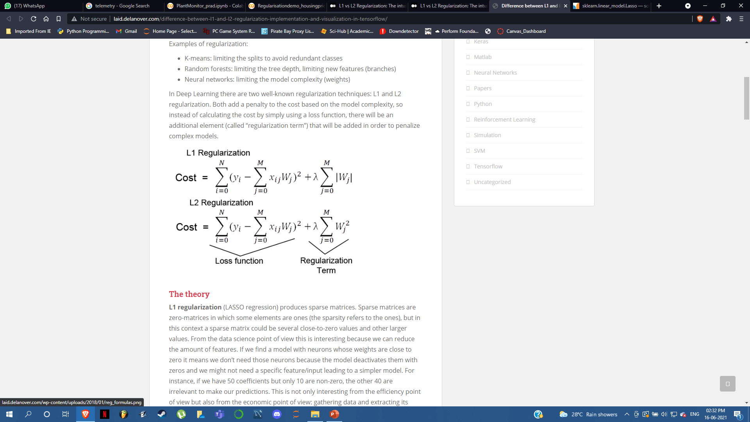
Difference between l1 and l2 regression

Slide 17
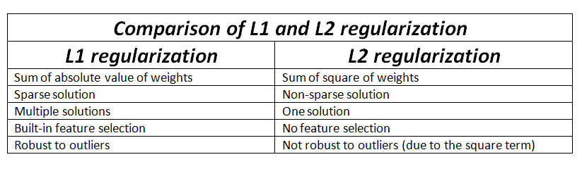
Difference between l1 and l2 regression

Slide 18
THE importance of bias variance tradeoff
When designing a machine learning model for a dataset that is linearly separable it is important to ensure that it is properly optimized.
If the cost function has high variance then the model is overfit which causes wrong predictions for any new data with noise in it, if it has high bias then the model is underfit.
It is important to find the right balance between bias and variance to ensure the model is optimised and there is space for noise in the dataset for future data points.

Slide 19
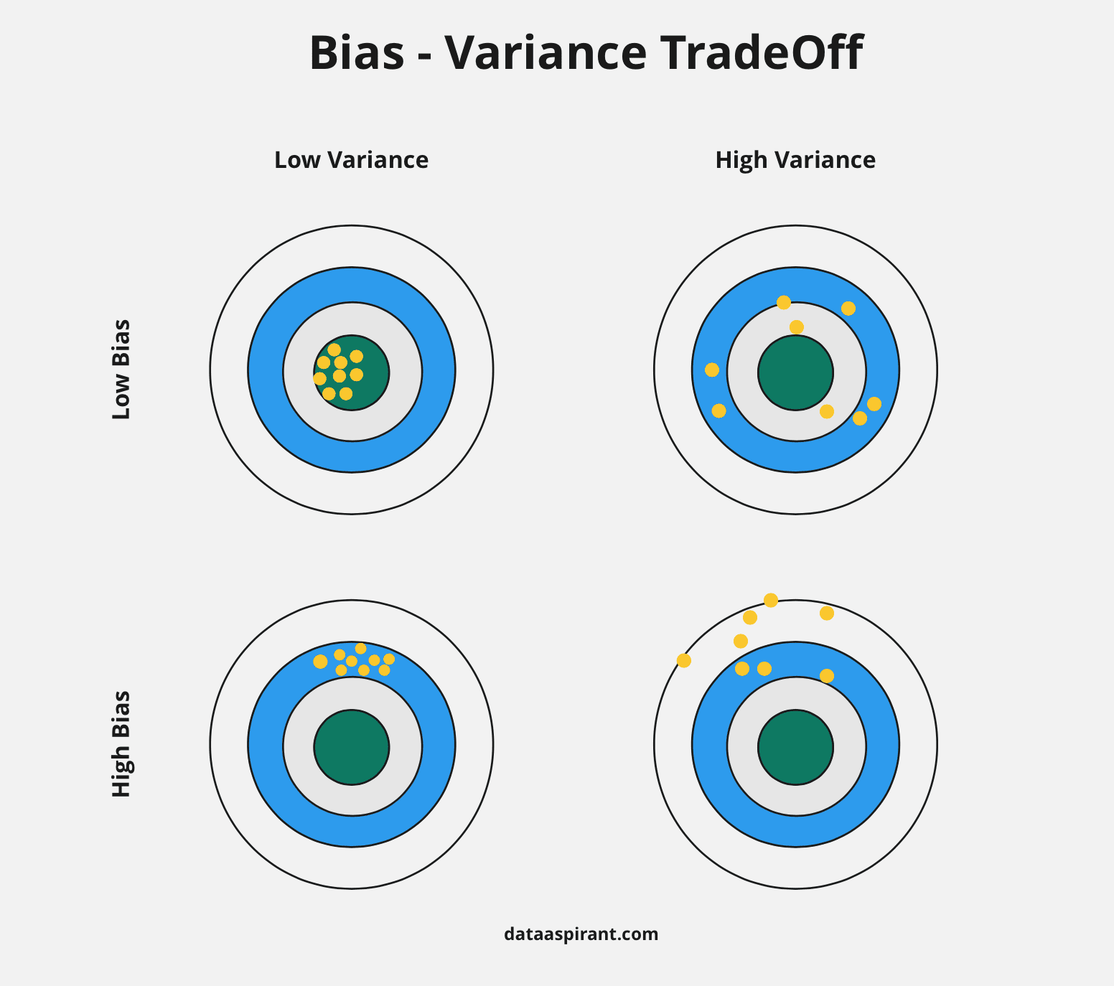
Bias variance tradeoff

Slide 20
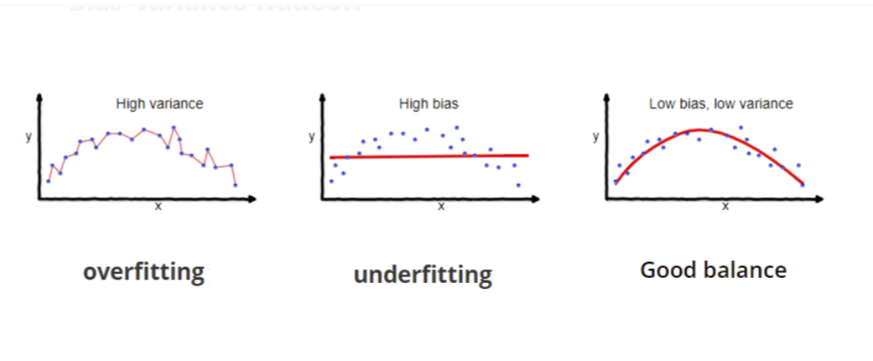
Effects of high low bias and variance

